Slide 1
CRYPTO WALLET
Submitted by:
Rasikh ur Rehman Natiq
Submitted to:
Sir Ahsan Shehzad

Slide 2
Objective:
To manage the coins of a crypto trader.
To manage profits

Slide 3
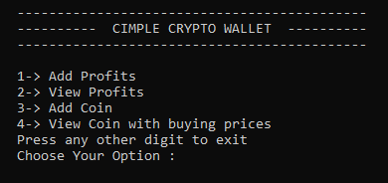
INPUT:

Slide 4
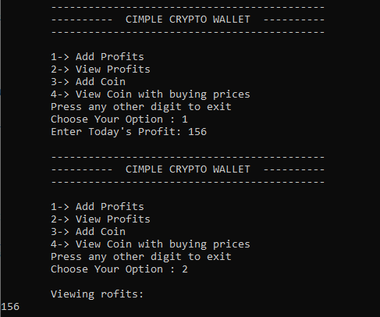
ADD and VIEW PROFITS:

Slide 5
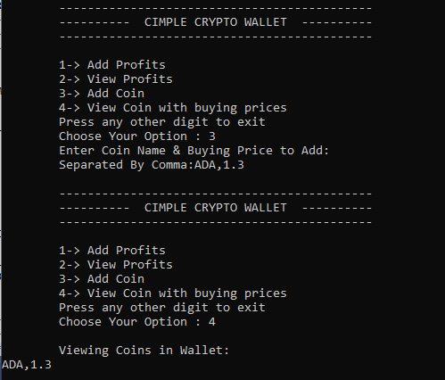
ADD and VIEW NEW COIN:

Slide 6
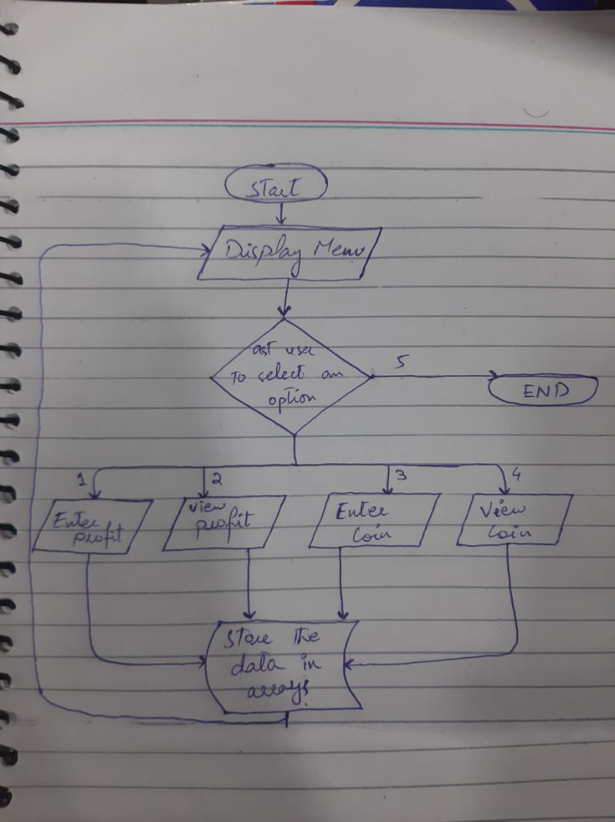
Flow Chart:

Slide 7
THANK YOU

